Slide 1
SMART INDIA HACKATHON • GAMES & TOYS • IPR-ORIENTED
BHARAT:
PROJECT TEAM
LIVIN IN INDIA
Rupak Kumar Dey
Concept & Complete Idea
An India-centric mobile life-simulation game where players experience education, careers, finances, relationships, migration and major life events through meaningful choices and evolving consequences.
Jayanti Mishra
Team Member
Priya Kumari
CORE IDEA
Team Member
A dynamic life engine that connects player state + regional context + validated socio-economic data to shape branching life-event probabilities.
Harsh Thakur
Team Member
Complete concept / idea by
Rupak Kumar Dey
Coordinator Pitch • Design Thinking + Invention Disclosure
01

Slide 2
The Problem: Indian life is complex — existing life-sims are mostly static
Design-thinking report + invention disclosure converge on the same technical gap.
01 CONTEXT GAP
02 DATA GAP
03 GAMEPLAY GAP
Existing life-simulation titles referenced in the study are built around Western/US systems and do not adequately represent Indian education, jobs, family structures and regional costs.
Indian socio-economic information is fragmented across sources and can appear in heterogeneous, sometimes non-machine-readable formats.
Static, pre-scripted outcomes can feel repetitive or arbitrary. Players want uncertainty — but also understandable, meaningful consequences.
ROOT CAUSE
No dedicated mechanism currently connects fragmented Indian socio-economic signals → normalized data → changing life-event probabilities → a branching narrative.
STATIC SCRIPTS
GENERIC ASSUMPTIONS
REGIONAL VARIATION
OPAQUE RANDOMNESS
BHARAT: LIVIN IN INDIA • Coordinator Pitch
02

Slide 3
The Design Insight
The breakthrough is not “more Indian content” — it is a dynamic relationship between player state, region and real-world signals.
INDIAN REALISM SHOULD BE GENERATED,
NOT JUST AUTHORED.
PLAYER STATE
REGION
The design-thinking report repeatedly narrows the opportunity toward a proprietary probability-calibration layer.
VALIDATED DATA
CALIBRATION ENGINE
LIFE EVENTS
New scenario → updated state → next probability set
BHARAT: LIVIN IN INDIA • Coordinator Pitch
03

Slide 4
Proposed Solution: BHARAT — LIVIN IN INDIA
A mobile life-simulation experience built around a reusable data-to-probability layer.
DATA INGESTION + NORMALIZATION
PROBABILITY CALIBRATION
BRANCHING LIFE ENGINE
Ingest heterogeneous Indian public/socio-economic sources.
Normalize format, granularity and update frequency into a structured schema usable by the simulation.
Translate normalized signals into weighted probabilities for branching life events — education, career, income trajectories, mobility and other milestones.
Use calibrated probabilities to generate decisions and outcomes, update life-stat variables, and re-calibrate as underlying datasets refresh.
PLAYER EXPERIENCE
Education
Career
Finance
Family
Mobility
Major Events
BHARAT: LIVIN IN INDIA • Coordinator Pitch
04

Slide 5
How It Works: Data → Probability → Story → Consequence
1
2
3
4
5
INGEST
NORMALIZE
CALIBRATE
GENERATE
UPDATE
Census / UDISE+ / PLFS / regional signals
Schema mapping • validation • reconciliation
Weighted probabilities + guardrails
Branching decision + outcome
Life-stat changes feed the next scenario
Example
A regional education signal changes → college-event probabilities change → player chooses → career/finance state updates → future events change.
BHARAT: LIVIN IN INDIA • Coordinator Pitch
05

Slide 6
What Makes the System Distinct?
The invention disclosure positions the core novelty in the combination — not in the generic idea of a life-simulation game.
In-game behaviour
BHARAT DIFFERENTIATOR
Existing dynamic game systems can adjust variables from player interaction data.
Our design: external socio-economic signals are the calibration input.
Sports/event simulation
BHARAT DIFFERENTIATOR
Data-trained probabilities exist in other simulation domains.
Our design: life-stage + socio-economic branching + heterogeneous Indian public data.
Chance/bonus games
BHARAT DIFFERENTIATOR
Probability modification can be tied to in-game monetary inputs.
Our design: real-world data drives narrative life outcomes, not payouts.
Static life sims
BHARAT DIFFERENTIATOR
Life outcomes can be linked to demographic databases.
Our design: intended dynamic ingestion + normalization + recalibration pipeline.
IP POSITIONING
Patentability remains subject to formal claim drafting, novelty/inventive-step review and applicable computer-implemented-invention requirements.
BHARAT: LIVIN IN INDIA • Coordinator Pitch
06

Slide 7
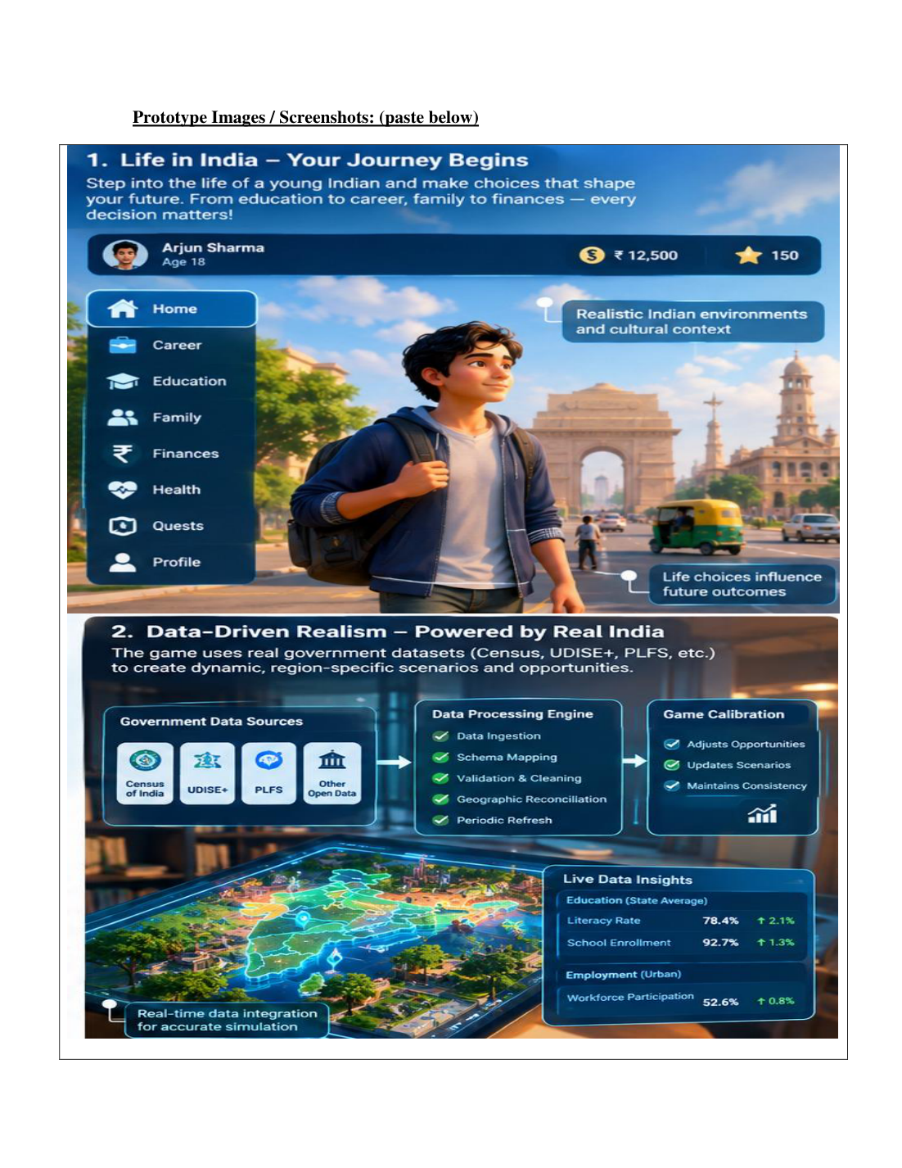
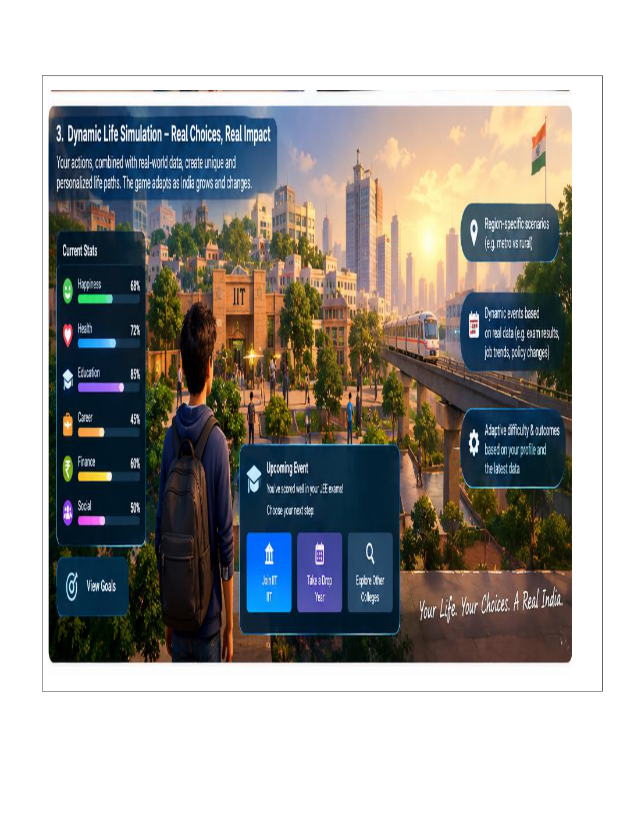
Prototype: Already Demonstrable
The submitted disclosure reports a 5-screen HTML/CSS/JS front-end prototype; the backend calibration engine is still at architecture/design stage.
HOME • CAREER • EDUCATION • QUESTS • PROFILE
DYNAMIC ENGINE = NEXT DEVELOPMENT PHASE
BHARAT: LIVIN IN INDIA • Coordinator Pitch
07

Slide 8
Player Journey: A Life Path That Evolves
Designed for short mobile sessions, replayability and meaningful consequences.
18
19–22
22–25
25–30
30+
START
LEARN
WORK
BUILD
CONSEQUENCES
State • family • education
College • skills • choices
Job • income • city
Savings • relationships • mobility
Long-term life state
Persistent life-stat layer
Education
Career
Finance
Social
BHARAT: LIVIN IN INDIA • Coordinator Pitch
08

Slide 9
Design Guardrails: Realism Without Losing Trust or Playability
DATA TRACEABILITY
REGIONAL FAIRNESS
Every branching event should map to a verifiable source field.
Represent state/city-tier diversity without stereotypes or over-generalisation.
PRIVACY BY DESIGN
EXPLAINABLE OUTCOMES
Protect and anonymise user data at every integration point.
Players should understand why a probability shifted.
LOW-END READY
PLAYER AGENCY
Target lightweight mobile performance and patchy connectivity.
Data shapes probabilities; it should not remove meaningful choice.
These principles are explicitly identified in the design-thinking report and invention disclosure.
BHARAT: LIVIN IN INDIA • Coordinator Pitch
09

Slide 10
Feasibility & Development Roadmap
The current scope is intentionally lightweight: prove the engine before building a full-scale game.
NOW
NEXT
6–10 WEEKS*
THEN
SCALE
UI/UX prototype
Calibration MVP
Backend prototype
Pilot
Product
5 interactive screens
Internal review complete
Ingest 1–2 datasets
Normalize + rule-based probability layer
Functional ingestion → calibration → event loop
10–15+ structured playtests
Measure usability + engagement
More states • languages • domains
Android/iOS production build
* The invention disclosure estimates 6–10 weeks for a functional backend prototype, subject to data access and team availability.
BHARAT: LIVIN IN INDIA • Coordinator Pitch
10

Slide 11
Why This Matters: One Engine, Multiple Outcomes
FOR GAMERS
FOR LEARNING
FOR IPR / PRODUCT
• Relatable Indian pathways
• Meaningful choices
• Replayability
• Regional authenticity
• Short-session mobile design
• Financial literacy
• Civic awareness
• Career exploration
• Consequence-based learning
• “What-if” experimentation
• Data-to-probability architecture
• Reusable calibration layer
• India-specific data integration
• Expandable across domains
• Potential IP portfolio
COMMERCIALIZATION SIGNAL
The disclosure identifies Indian gaming, NRI/diaspora users, and ed-tech/CSR organisations as potential markets; it also lists Nazara, WinZO, Games2win, Moonfrog and JetSynthesys as possible commercialization contacts.
BHARAT: LIVIN IN INDIA • Coordinator Pitch
11

Slide 12
THE ASK
Help us move from a compelling prototype
to a defensible technical demonstrator.
01
IP guidance
Validate claim scope and filing strategy before exposing the core engine.
02
Data access
Identify reliable, permissible Indian public datasets / APIs for an MVP.
03
Prototype support
Build the ingestion + normalization + calibration loop.
04
Pilot users
Run structured playtesting and document evidence.
Core proposition:
Data-grounded Indian realism + persistent life-state + dynamic branching = a new way to simulate “what if?”
BHARAT: LIVIN IN INDIA • Coordinator Pitch
12

